Slide 1
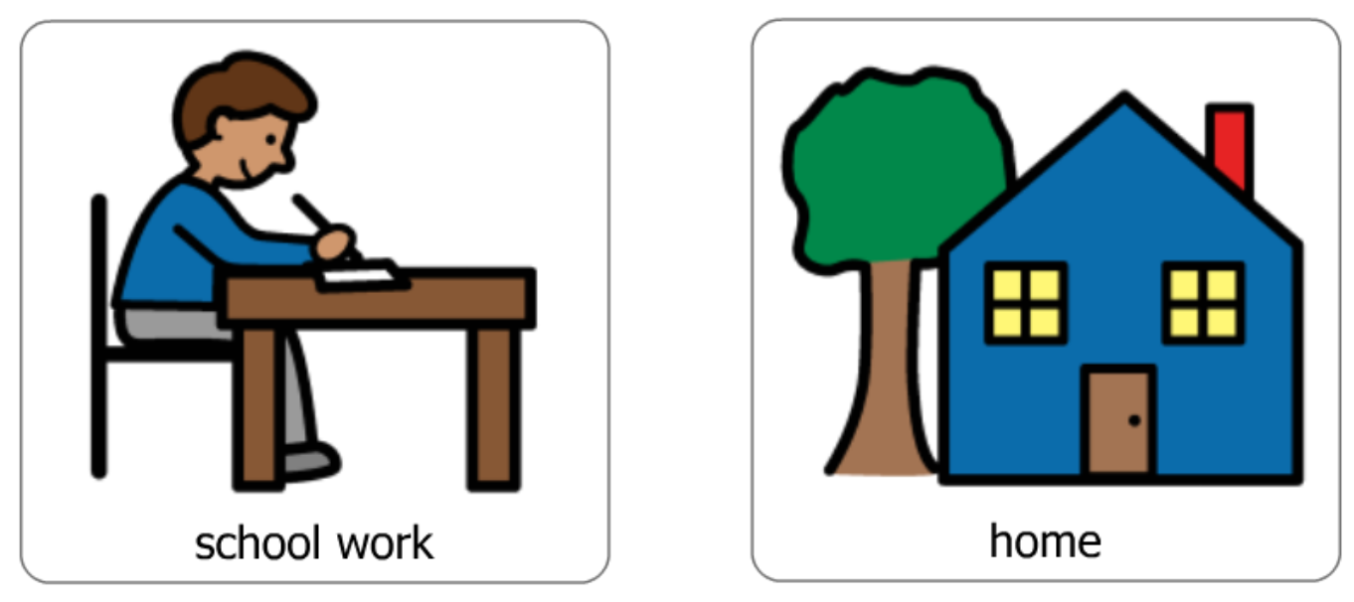
School Work At Home

Slide 2
Things are going to be a little different

Slide 3
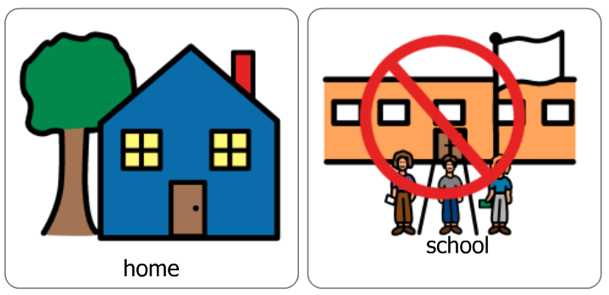
Because of the virus, I will be staying at home instead of going to school

Slide 4
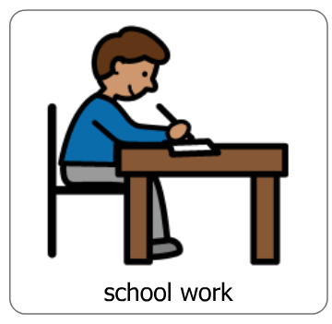
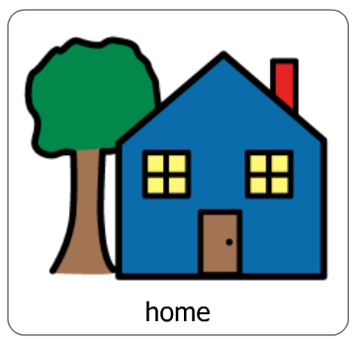
I will be doing school work at home

Slide 5
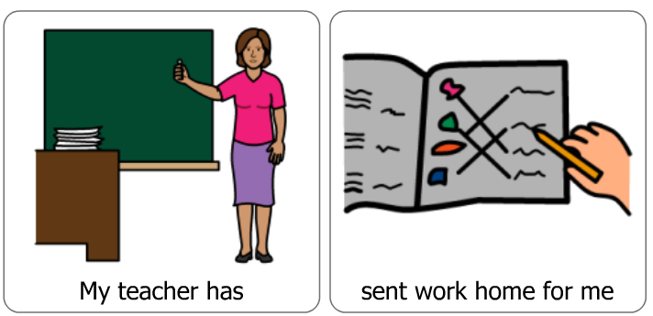
My teacher has sent work home for me to do

Slide 6
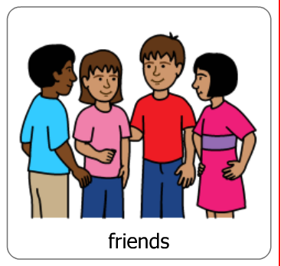
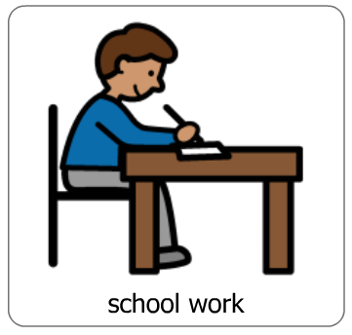
All of my friends will be doing their school work at their houses too

Slide 7
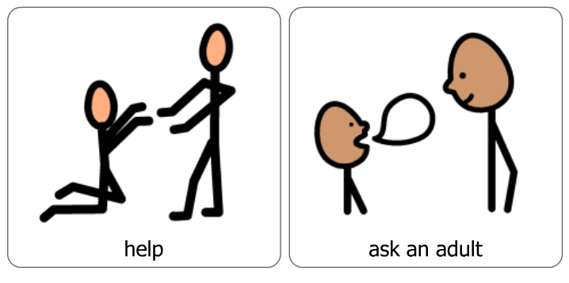
Sometimes, I might need some help with my school work. I can ask an adult at home to help me.

Slide 8
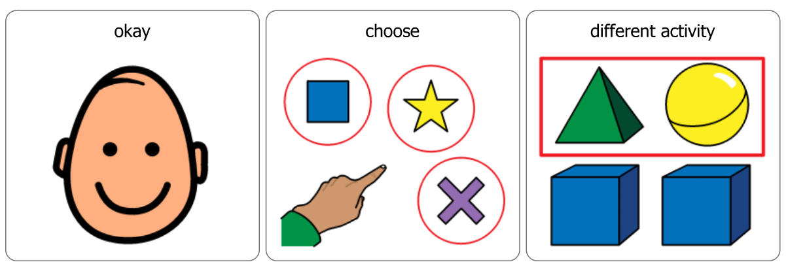
If an adult can’t help, it is okay. I can do other activities that my teacher has sent.

Slide 9
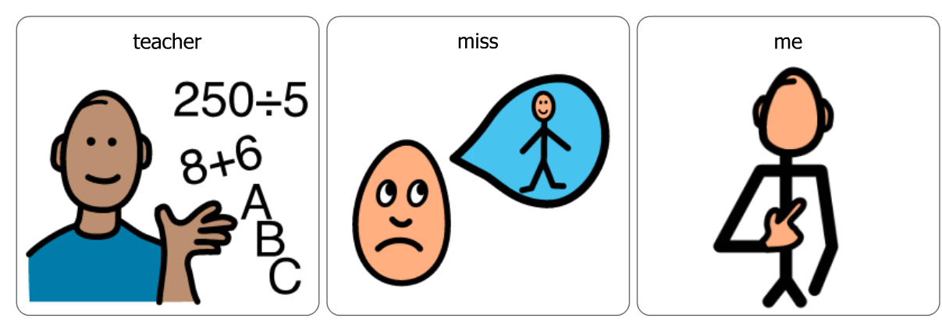
My teacher will really miss seeing me everyday

Slide 10
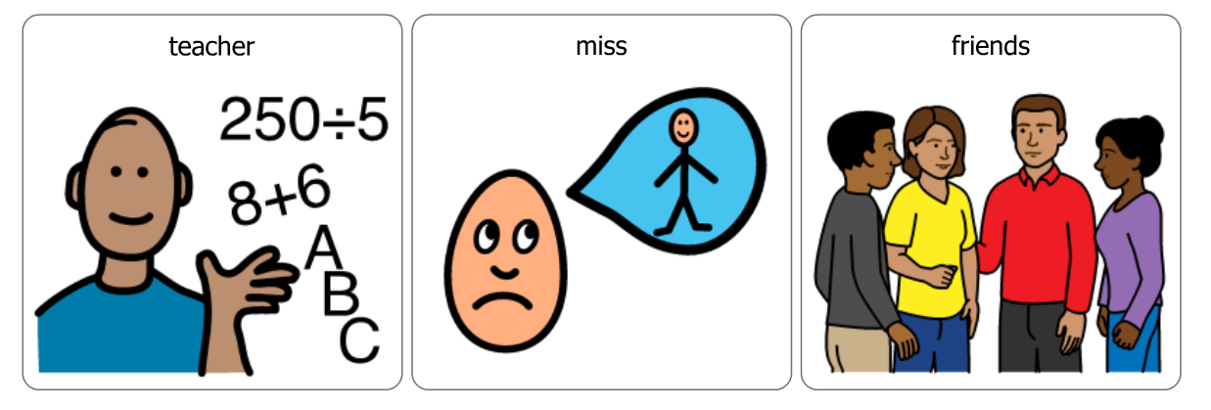
My teacher will miss my friends too

Slide 11
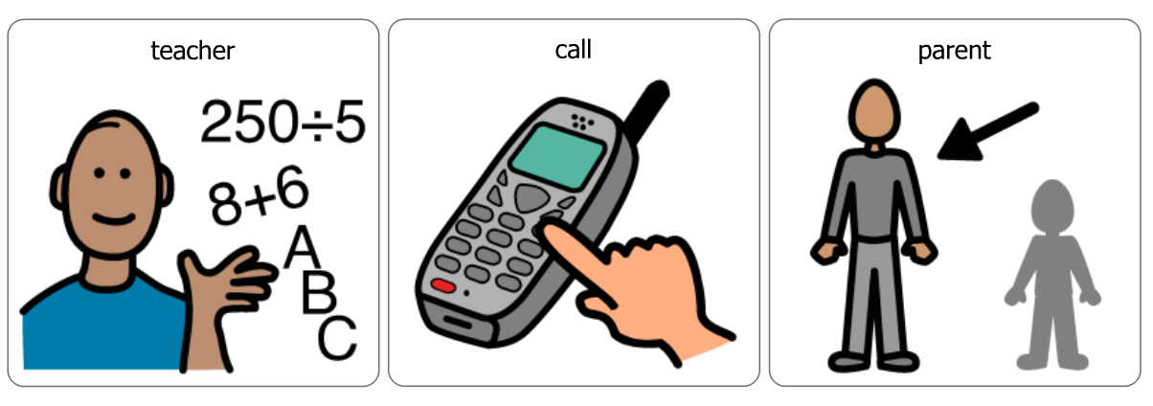
My teacher will call my parents to make sure I am going okay!

Slide 12
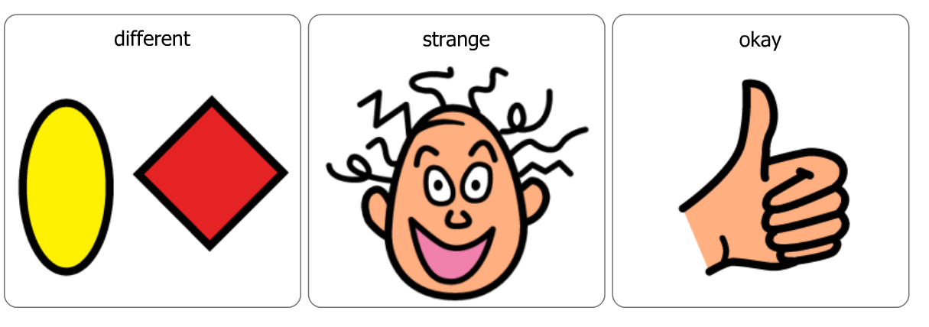
Doing my school work at home is a little different and might feel strange. That is okay.

Slide 13
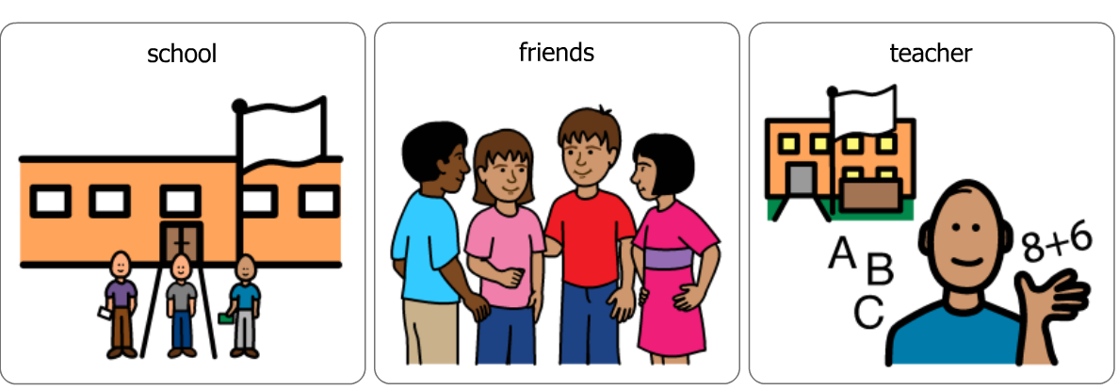
One day I will be able to go back to school and see my teacher and friends again.

