Slide 1
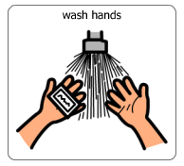
Washing my hands

Slide 2
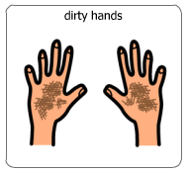
I wash my hands when they are dirty

Slide 3
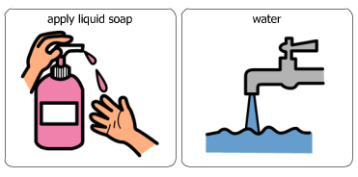
I wash my hands with soap and water

Slide 4
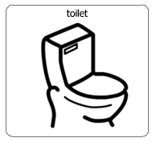
I wash my hands after I go to the toilet

Slide 5
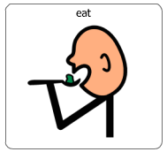
I wash my hands before I eat my food

Slide 6
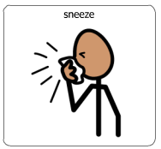
I wash my hands if I sneeze into them

Slide 7
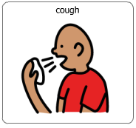
I wash my hands if I cough into them

Slide 8
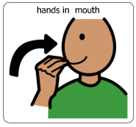
I need to wash my hands if I put them in my mouth

Slide 9
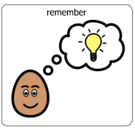
It is important to remember to wash my hands

Slide 10
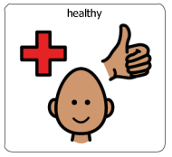
When I wash my hands, I keep myself healthy

Slide 11
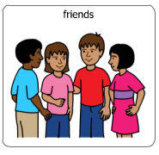
When I wash my hands, I keep my friends healthy

Slide 12
Washing my hands is important

