Slide 1
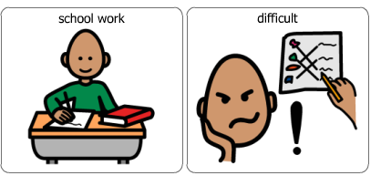
When school work is difficult

Slide 2
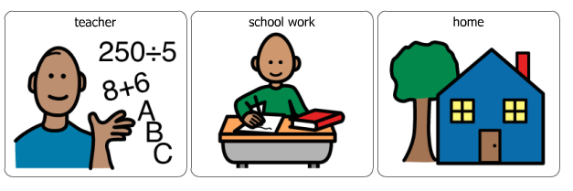
My teacher has sent school work for me to do at home

Slide 3
This work might be reading, writing, spelling, maths or something different.

Slide 4
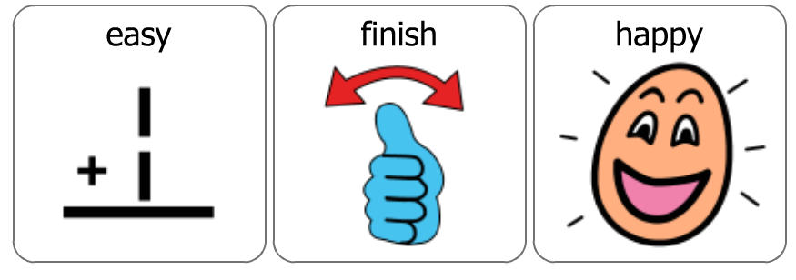
Some of this work, I will find easy and this will make me feel happy.

Slide 5
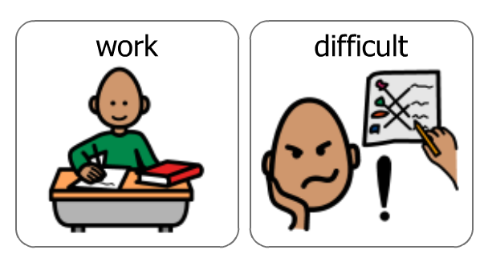
Sometimes I might find the work a little bit difficult

Slide 6
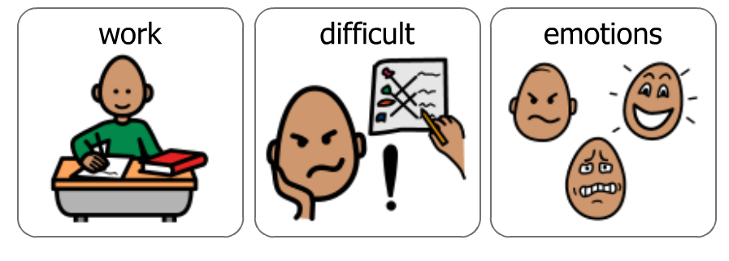
When school work is difficult, it can make me feel different feelings.

Slide 7
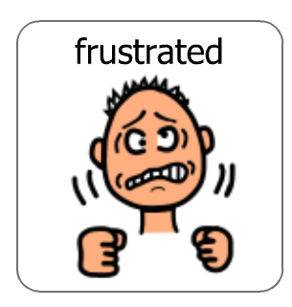
I can feel frustrated that I can’t work out how to do it

Slide 8
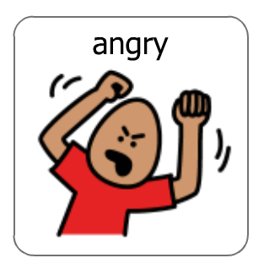
I can feel angry that I’m not getting it right

Slide 9
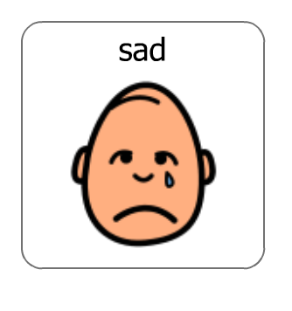
I can get sad if I get an answer wrong

Slide 10
It is okay to feel these feelings

Slide 11
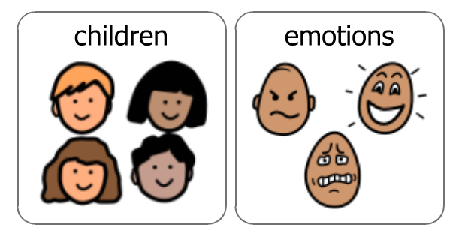
It is important to remember that the other students in my class will also have these feelings

Slide 12
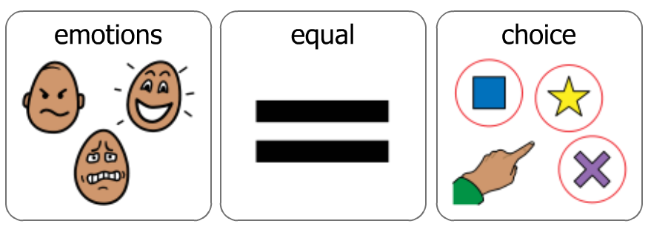
When I am doing my school work and I start to feel frustrated, angry or sad, there are some things I can do to make myself feel better

Slide 13
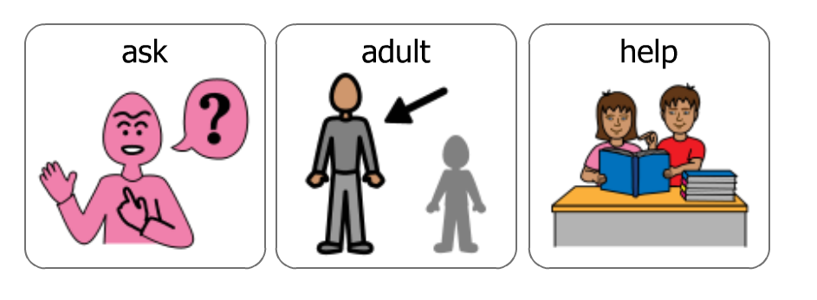
I can ask an adult to help me

Slide 14
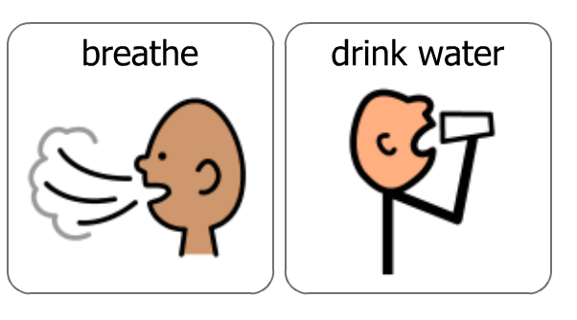
I can take some deep breaths or have a drink of water

Slide 15
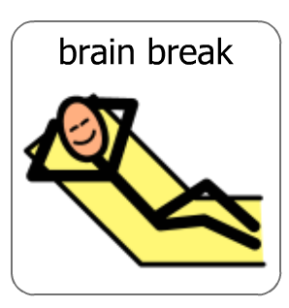
I can have a brain break and try to relax

Slide 16
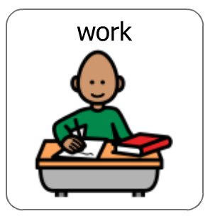
Once I have tried these activities, I can try doing my school work again

Slide 17
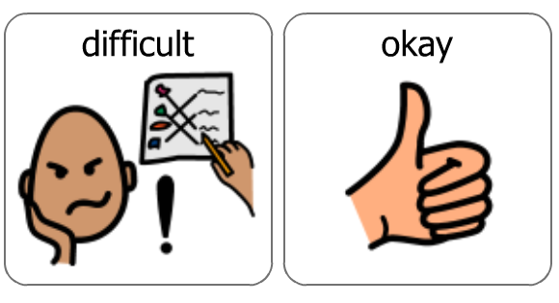
It is okay to find school work difficult

Slide 18
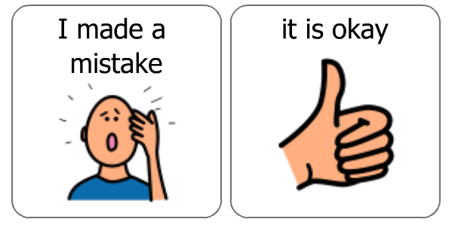
It is okay to make mistakes when I am doing my school work

